Slide 1

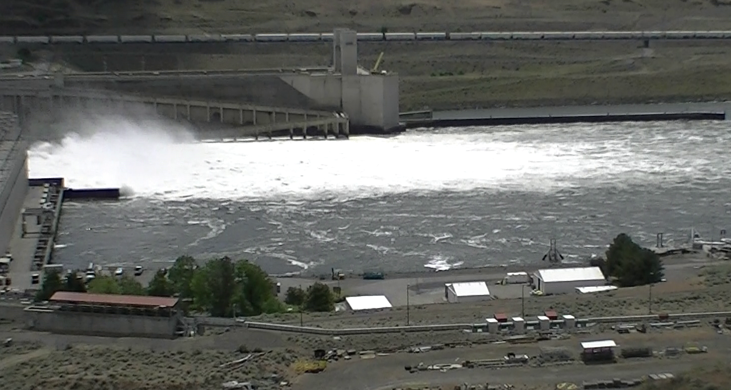
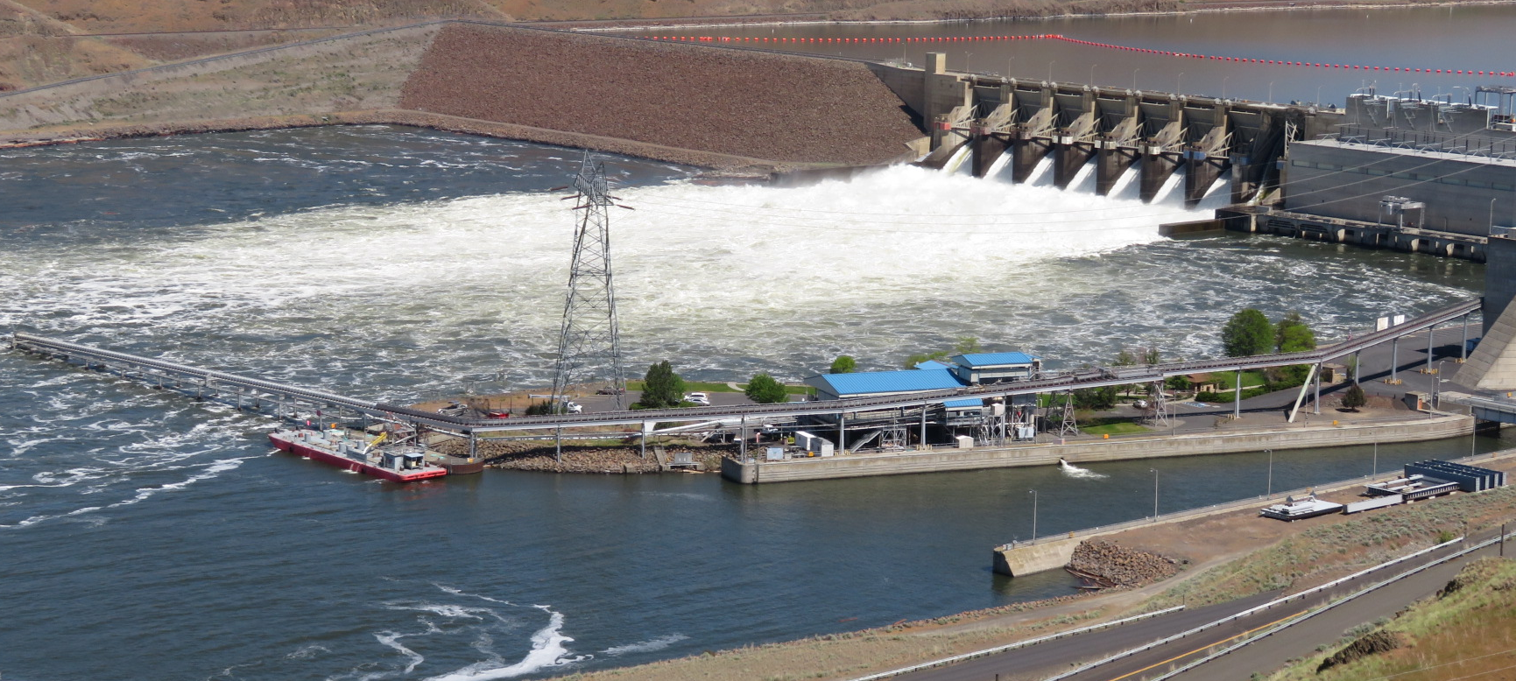
TOTAL DISSOLVED GAS MONITORING AT LMA & LGA 2020 & 2021
Jon Renholds
NWW H&H Branch
FPOM – 14 Aug 2022

Slide 2
background
TDG was monitored at fixed sites in the forebay and tailrace of each Snake River Dam.
  Fixed sites were established based on powerhouse & spill operations in mid-1990’s
Current fish passage plan requires significantly more spill than the 1990’s levels
Spill level is based on the States approved TDG level (125% TDG) as measured at tailrace fixed monitoring sites.
  Forebay monitoring sites remain in place.
In 2020, TDG was at times higher in the forebay of some dams than it was within the tailrace of the upstream dam.
Question:
Do the tailrace fixed monitoring sites accurately represent TDG conditions in the Snake River under the current spill program?

Slide 3
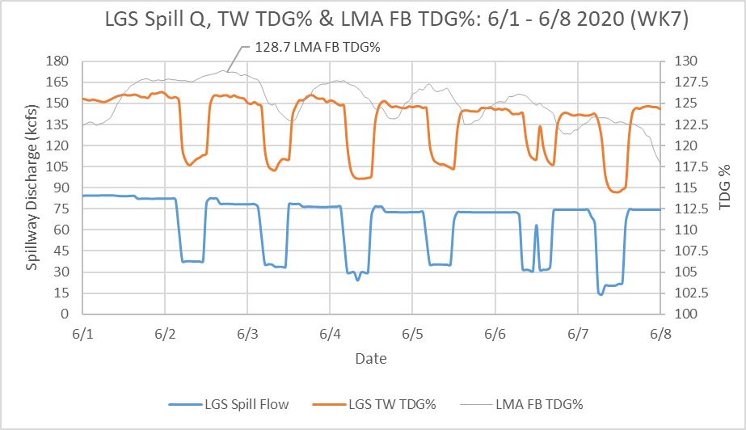
Little goose tdg in 2020
  Little Goose Tailwater TDG compared to Lower Monumental Forebay TDG
  LMA Forebay TDG% exceeded 125% for long periods
Notes:
LMA Forebay TDG% averaged near 125% for 2-week peak spill.
Early in season small decrease over reservoir as typical but LMA FB often exceeded LGA TW at highest spill
Variable travel time can make difficult to directly compare

Slide 4
Little goose tdg in 2020
  Little Goose Tailwater TDG compared to Lower Monumental Forebay TDG
  LMA Forebay TDG% averaged near 125% for 2-week peak spill.
  Early in season small decrease over reservoir as typical but LMA FB often exceeded LGA TW at highest spill
  Variable travel time can make difficult to directly compare

Slide 5
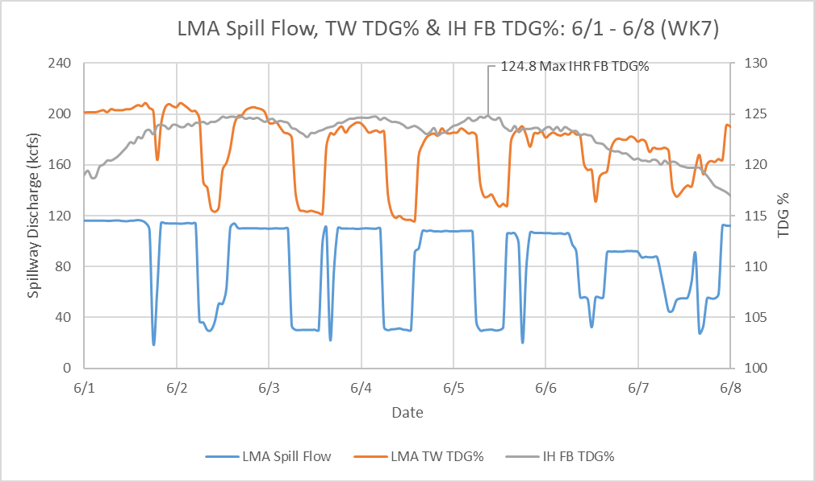
Lower monumental tdg in 2020
  Lower Monumental Tailwater TDG compared to Ice Harbor Forebay TDG
  IHR Forebay TDG% exceeded 125% occasionally
Notes:
IHR Forebay TDG% averaged above 122% for 2-week peak spill.
For most of season small decrease over reservoir as typical but no decrease between LMA TW and IHR FB at highest spill
Variable travel time can make difficult to directly compare

Slide 6
Lower monumental tdg in 2020
  Lower Monumental Tailwater TDG compared to Ice Harbor Forebay TDG
  IHR Forebay TDG% averaged above 122% for 2-week peak spill.
  For most of season small decrease over reservoir as typical but no decrease between LMA TW and IHR FB at highest spill
  Variable travel time can make difficult to directly compare

Slide 7
Fixed tw stations representative?
Supplemental TDG data indicate the fixed tailrace monitoring sites may no longer represent total river TDG conditions
Possible Reasons:
  The 125% gas cap spill, as a percentage of overall river flow, is significantly greater than any previous spill operations & certainly higher than conditions under which TW stations were established.
  Large eddies are set up below the powerhouse with a significant portion of the spill being re-entrained within the spillway stilling basin beneath the deflected flow jets
Notes:
Need to really emphasize in the following slides the entrainment of flow; the arrows showing the recirculation of flow don’t really show the true magnitude of the re-entrained flow.

Slide 8
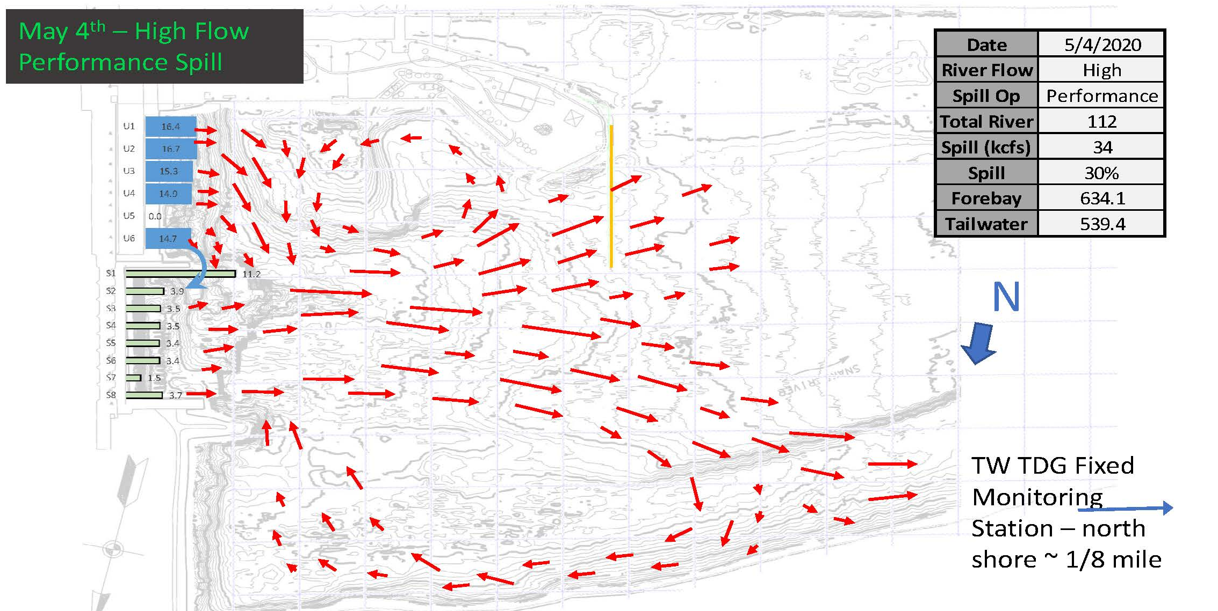
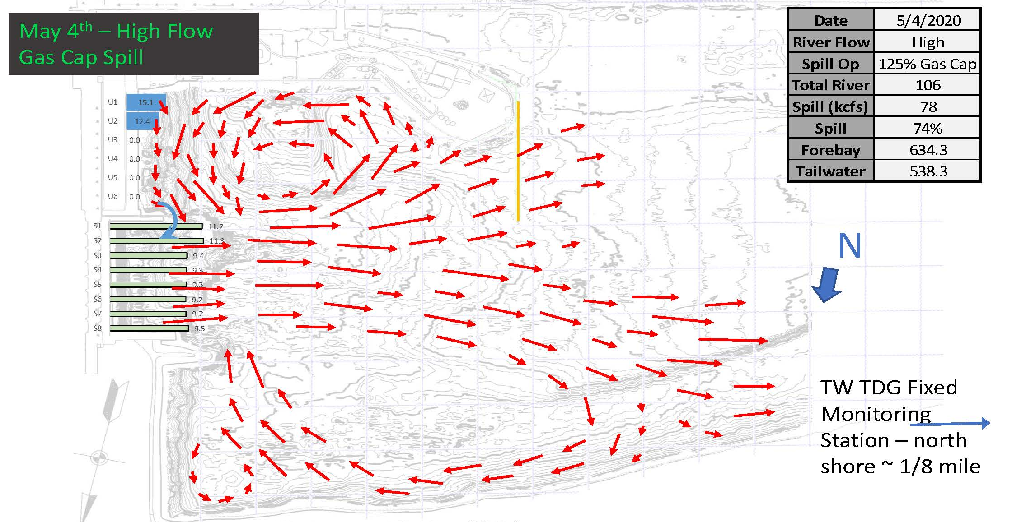
LITTLE GOOSE DAM
2020 SPRING TAILRACE CONDITIONS
Performance Spill
    Eddies on both sides typical with any significant spill due to topography
    Entrainment into spill flow primarily PH with minor re-entrainment of spillway
125% Gas Cap Spill
  Intense Eddies on both sides not pushed downstream by PH flow
  Entrainment into spill flow primarily re-entrainment of spillway
Notes:
A critical observer will ask why the north shore eddy does not also gas up the river and therefor the fixed monitoring station should be representative of the re-entrained flow. Shallow bench on north side of spillway does reduce some of the TDG buildup from the north shore eddy.

Slide 9
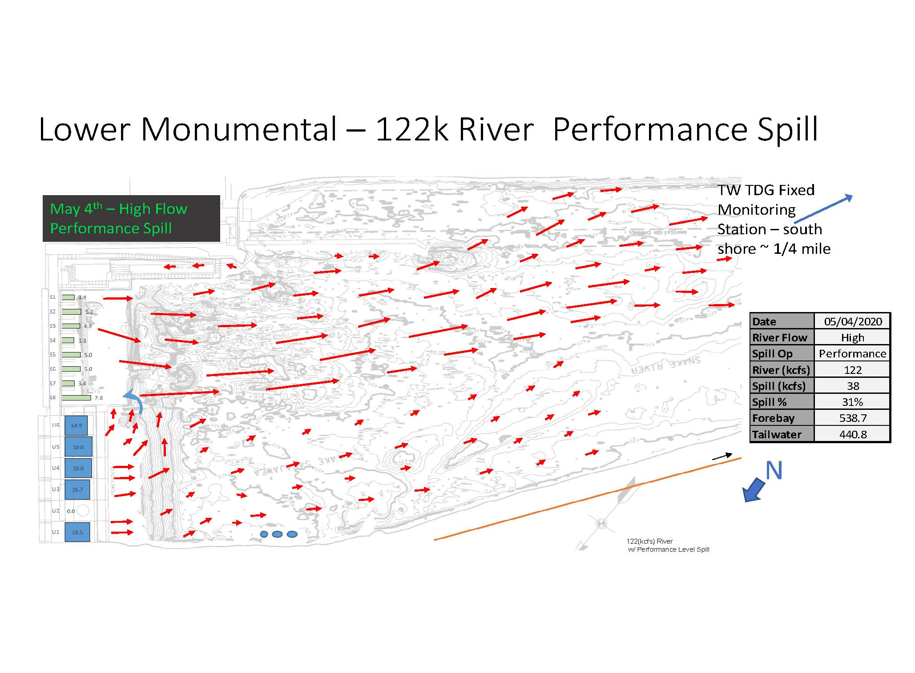
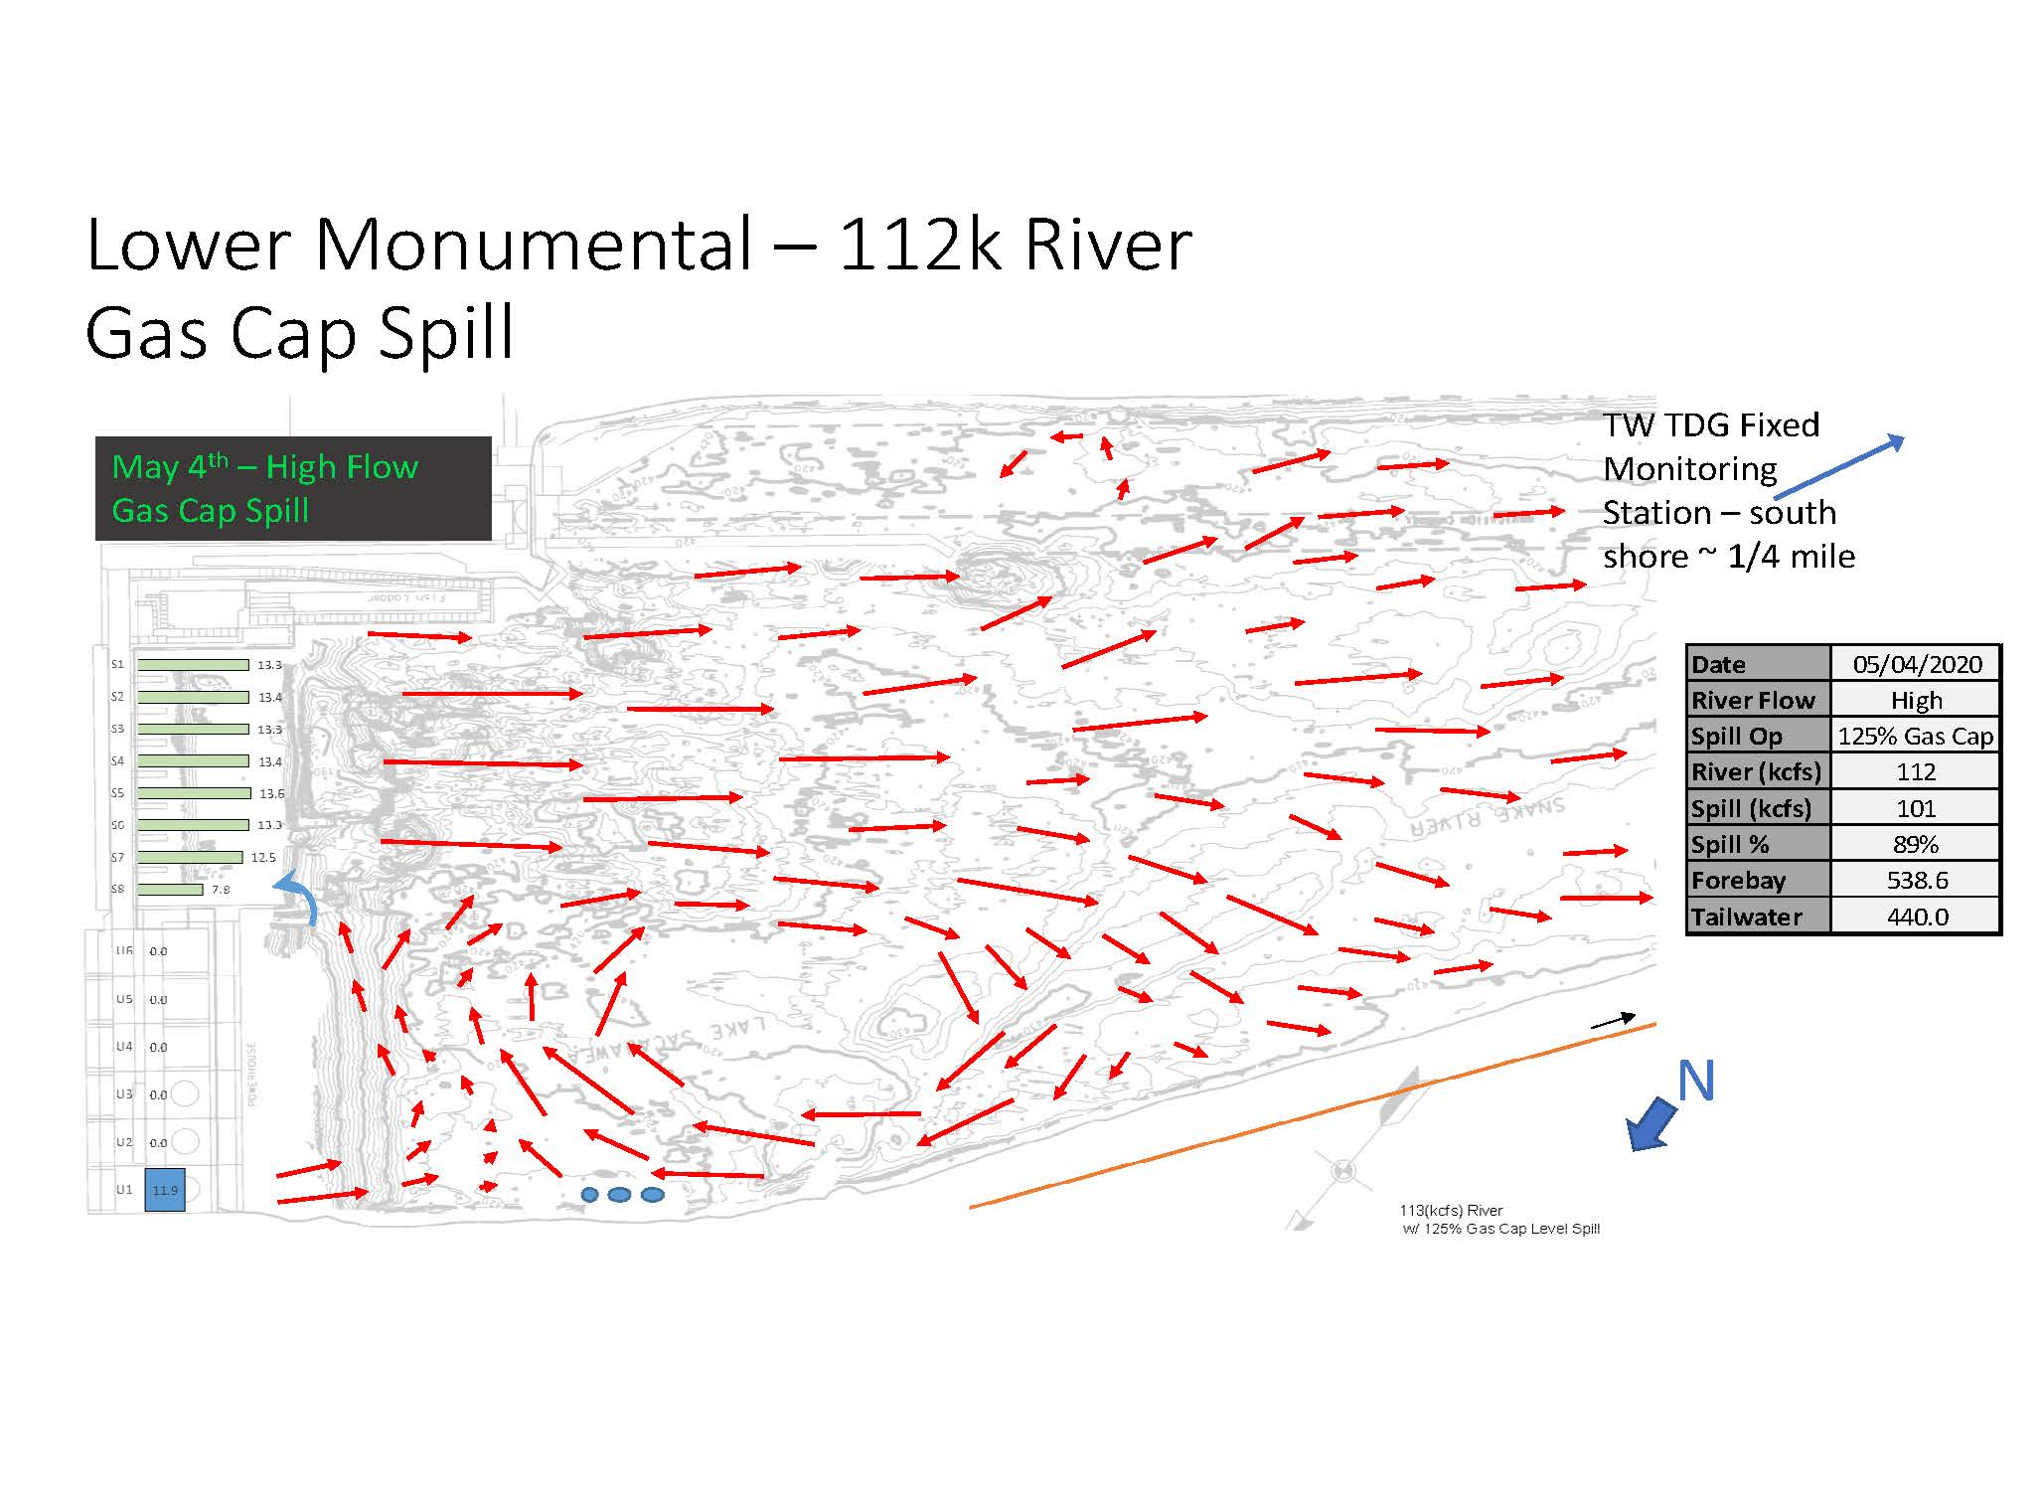
LOWER MONUMENTAL DAM
2020 SPRING TAILRACE CONDITIONS
Performance Spill
    Downstream flow for full river
    Entrainment into spill flow primarily PH
125% Gas Cap Spill
  Intense Eddies on north shore
  Entrainment into spill flow primarily re-entrainment of spillway

Slide 10
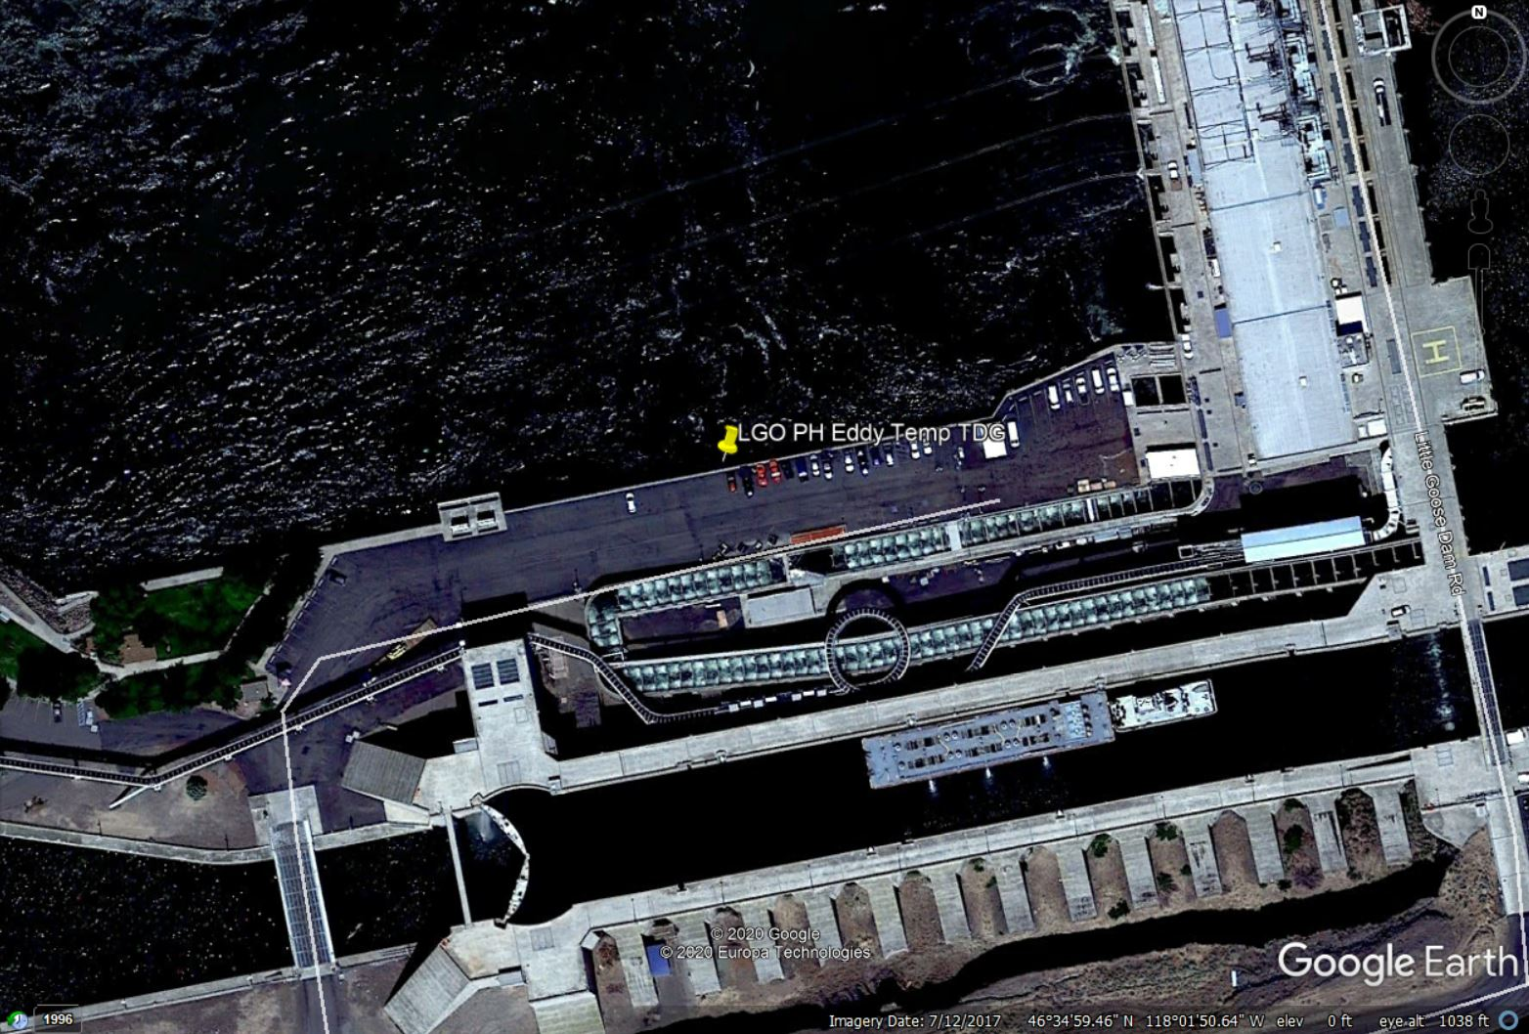
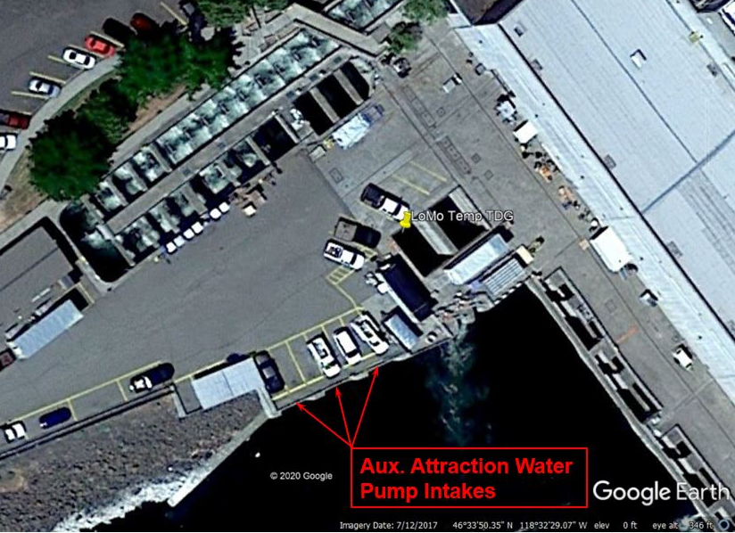
Supplemental tdg monitoring in 2020 lower monumental and little goose dams
Added several temporary TDG monitoring locations in 2020 in areas of concern
    Compared to fixed monitoring sites
Little Goose Dam
In Eddy near PH
Lower Monumental Dam
Inside Fishway Entrance
Notes:
The question Division had was why did we do this? The answer I provided was that we observed the forebay data and we saw the re-entrained flow and theorized the higher tdg saturation was coming from the re-entrained flow below the powerhouse and saw the need to study this to determine if in in fact this was the cause.

Slide 11
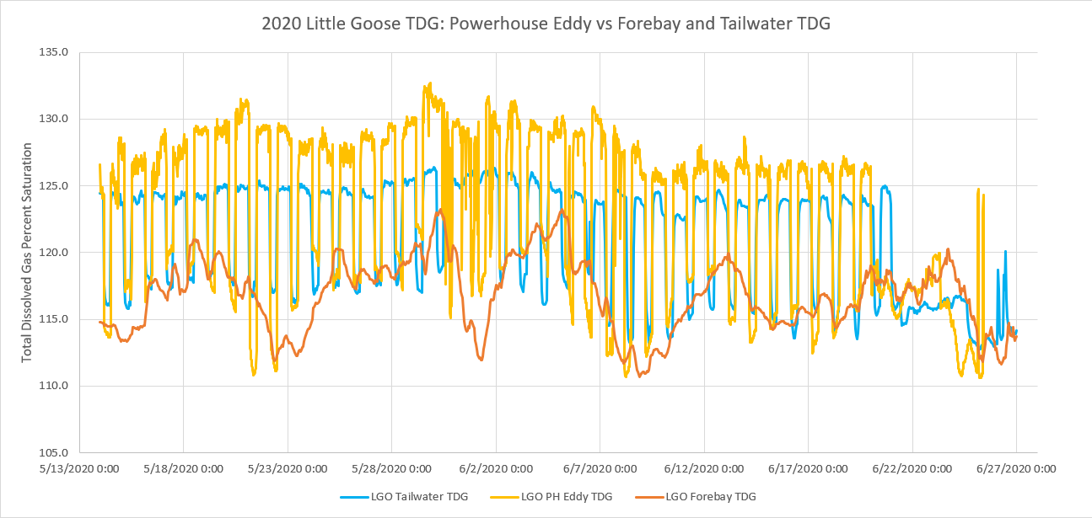
Little goose ph eddy tdg in 2020
PH eddy TDG near tailrace TDG% during performance spill but 3% to 7% greater and often exceeding 130% TDG during 125% gas cap spill
Due to the 125% gas cap spill tailrace patterns, high TDG% water eventually escapes down south shore opposite the fixed tailwater monitoring station
Notes:
TDG levels within the PH eddy were similar to the Fixed Monitor TDG levels during performance spill, but 3% to 7% greater and often exceeding 130% TDG during 125% gas cap spill
High TDG levels from the PH eddy remain on the Powerhouse side of the river and are not detected by the Fixed Monitoring Stations during 125% gas cap spill operations

Slide 12
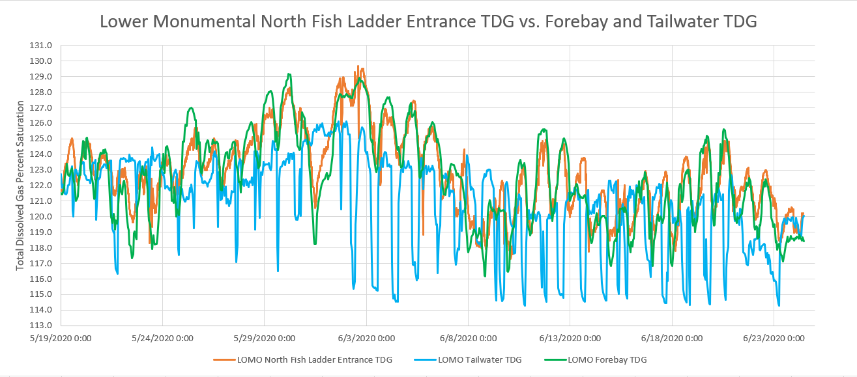
2020 - LOwer mon. n. shore fishway
TDG in the fishway is unaffected by Lower Monumental eddy.
TDG followed forebay TDG due to fishway turbine supply. Therefore, higher TDG in this area primarily due to Little Goose spill

Slide 13
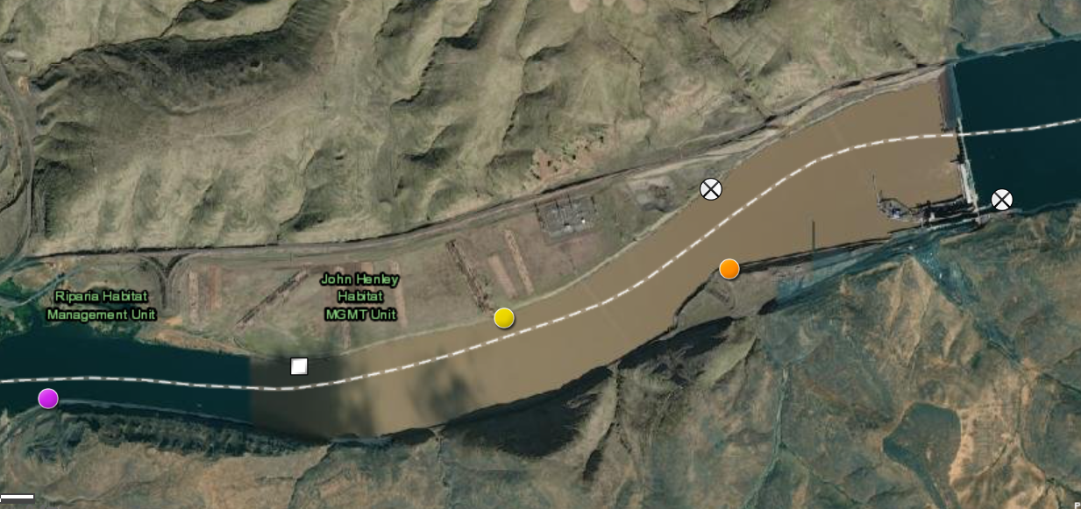
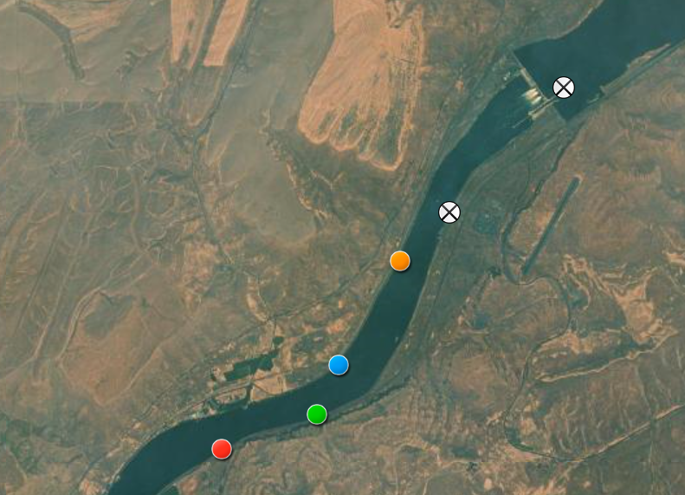
Supplemental tdg monitoring in 2021 lower monumental and little goose dams
2020 supplemental monitoring confirmed higher TDG in re-entrained flow at Little Goose and Lower Monumental dams.
2021 sites added below powerhouse and four locations downstream
TDG data compared to fixed monitoring sites and forebay sites of the next downstream dams
Fixed TW
Fixed FB
Fixed FB
Fixed TW
Little Goose Dam
Lower Monumental Dam

Slide 14
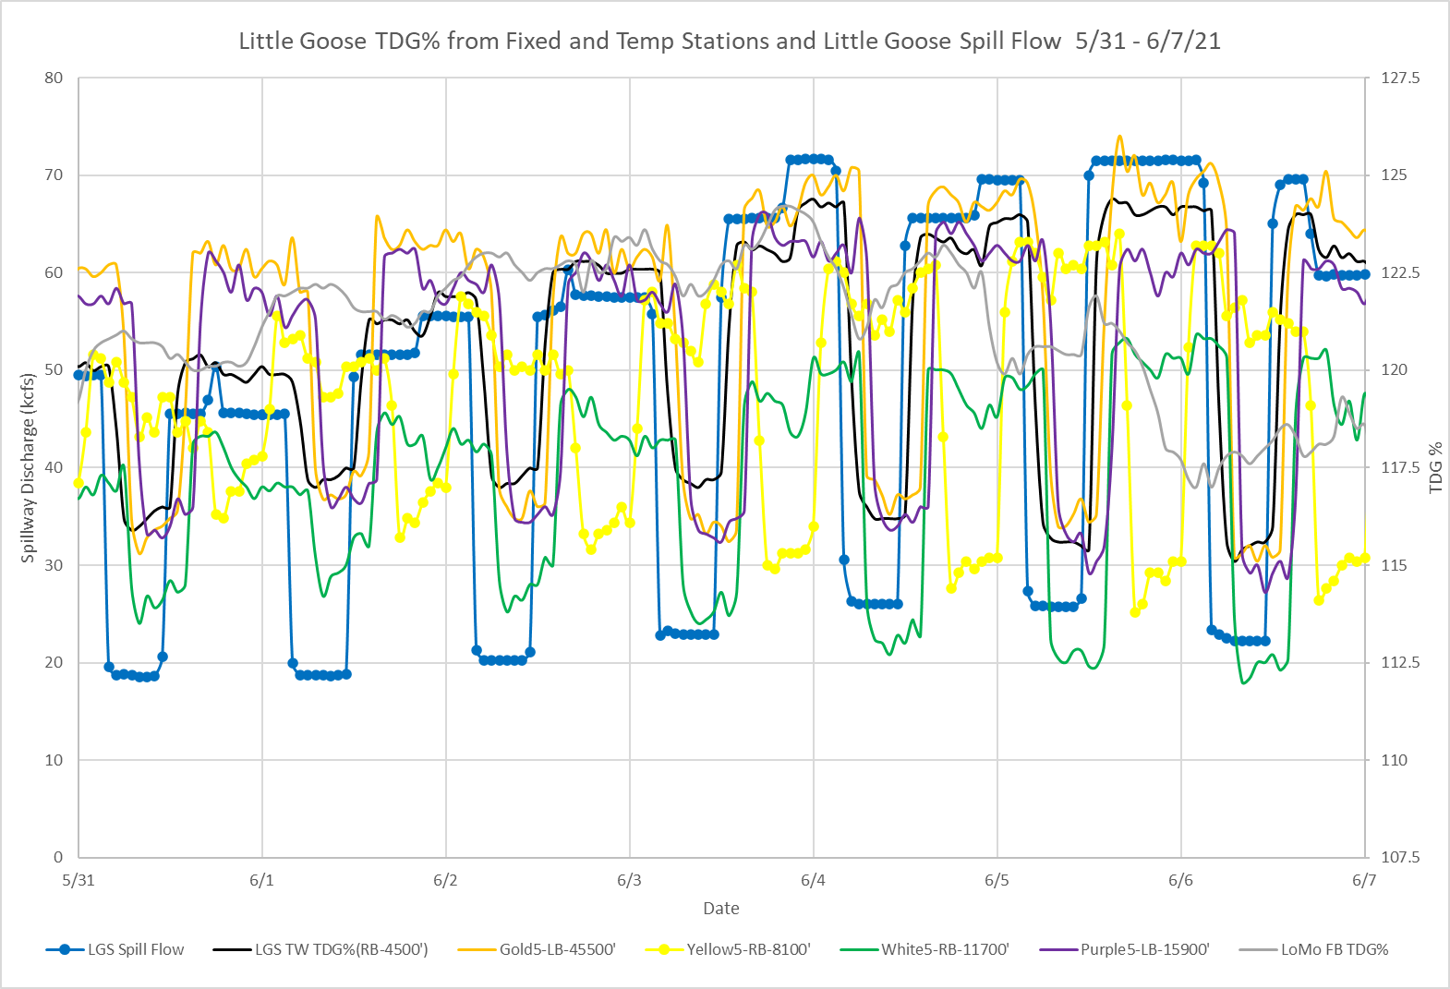
Little goose tdg monitoring in 2021
Lower river discharges in 2021 so fixed site never reached 125% TDG
Fixed TW
Fixed FB
Notes:
Lower Monumental forebay was not as high as 2020
During highest spill week, “Gold-5” exceeded the fixed site consistently during 125% gas cap spill
North shore sites (yellow & white (shown green)) were much lower & further downstream (purple) was usually close to fixed site

Slide 15
Little goose tdg monitoring in 2021
Lower river discharges in 2021 so fixed site never reached 125% TDG
    Lower Monumental forebay was not as high as 2020
    During highest spill week, “Gold-5” exceeded the fixed site consistently during 125% gas cap spill
    North shore sites (yellow & white (shown green)) were much lower & further downstream (purple) was usually close to fixed site
Fixed FB
Fixed TW

Slide 16
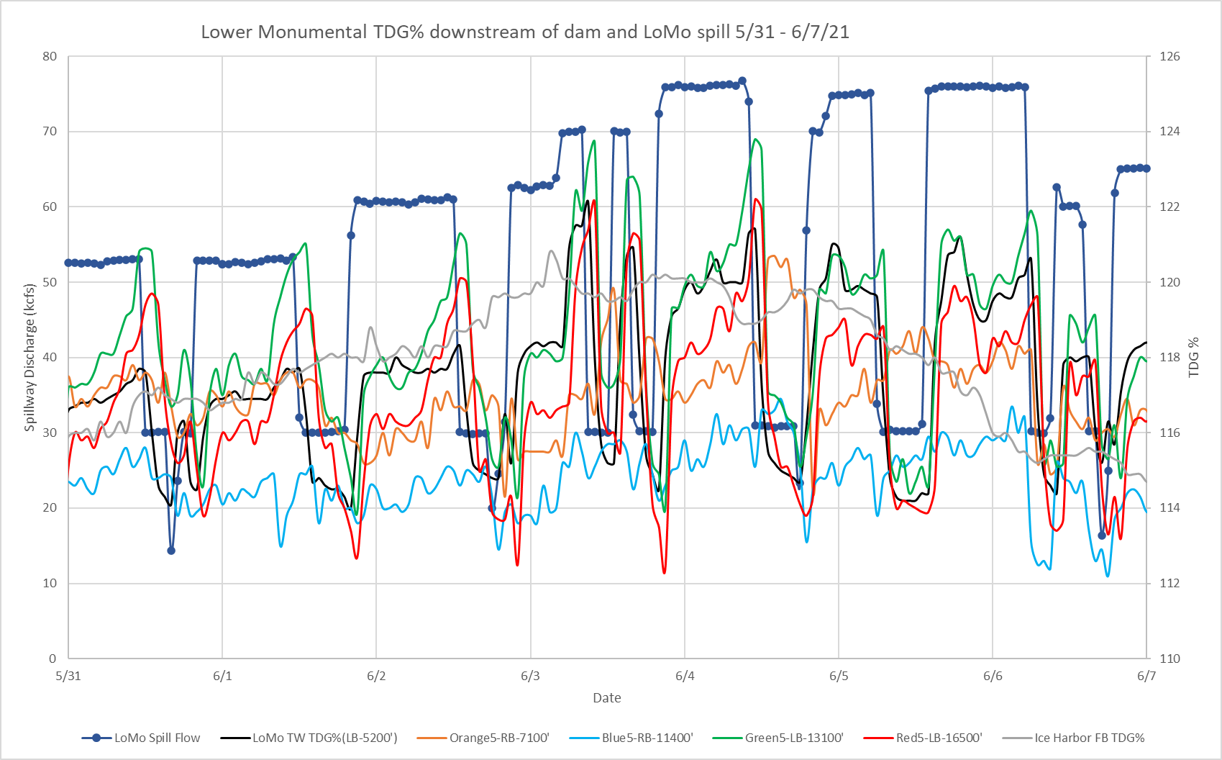
Lower mon. tdg monitoring in 2021
Lower river discharges in 2021 so fixed site never reached 125% TDG
Fixed FB
Fixed TW
Notes:
Ice Harbor forebay was not as high as 2020 but still exceeding LMA TW at times
“Green-5” exceeded the fixed site consistently over many weeks
Blue consistently lower but others mixed

Slide 17
Lower mon. tdg monitoring in 2021
Lower river discharges in 2021 so fixed site never reached 125% TDG
    Ice Harbor forebay was not as high as 2020 but still exceeding LMA TW at times
    “Green-5” exceeded the fixed site consistently over many weeks
    Blue consistently lower but others mixed
Fixed FB
Fixed TW

Slide 18
summary
2020 TDG data indicate the fixed TW monitoring station does not accurately measure TDG levels representative of the total river conditions during high spill with little PH flow.
2021 river flow was lower than 2020. The 125% gas cap levels were seldom reached and conclusions unclear
Based on previous data and continued 125% gas cap spill, it is prudent to:
  Maintain Forebay monitoring sites at all dams
  Monitor at least 2 of the 2021 temporary sites downstream of Lower Monumental and Little Goose dam in 2022
    Forecast for Snake River flow is below average; observations may be similar to 2021
  Consider more robust TDG exploration in the future similar to transect studies in 2004 (LMA) & 2007 (LGA)

Slide 19
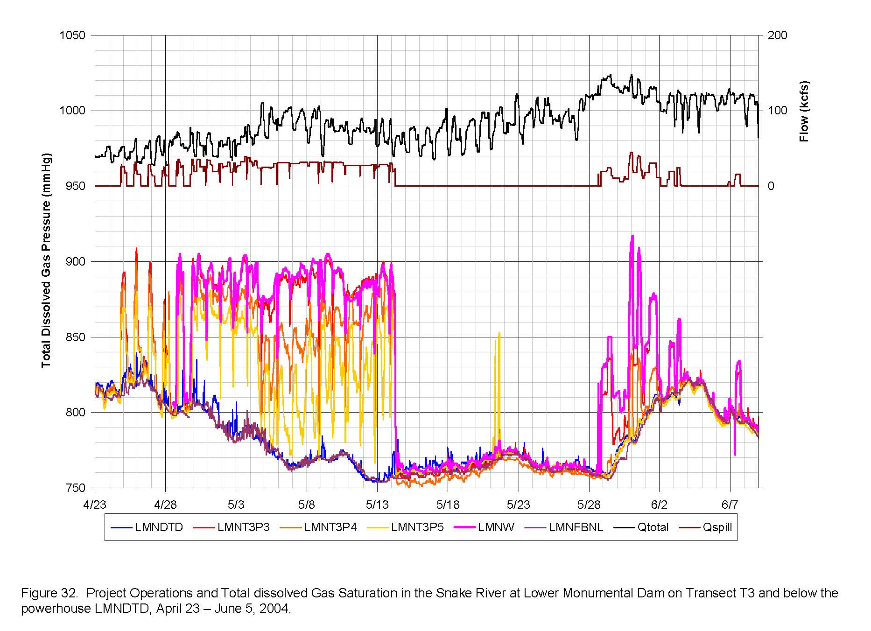
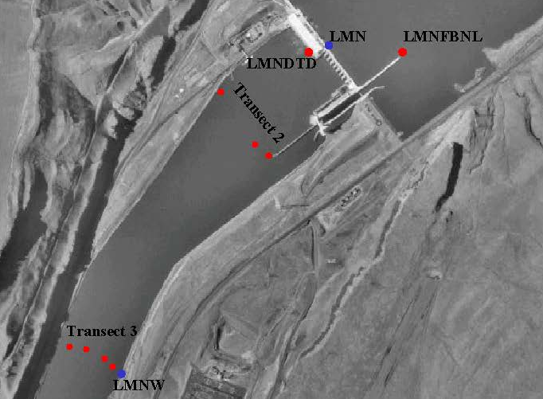
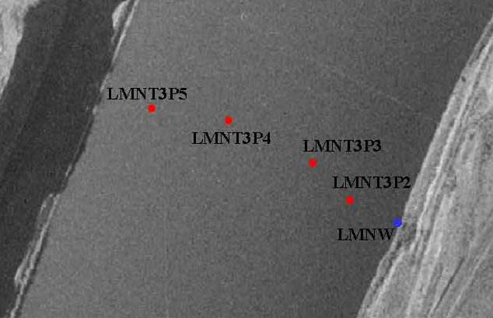
Bonus slide – only if interest or time
2004 Lower Monumental TDG study after end bay deflectors added
  South bank or fixed TW station always highest TDG for T3 transect under study spill conditions

Slide 20
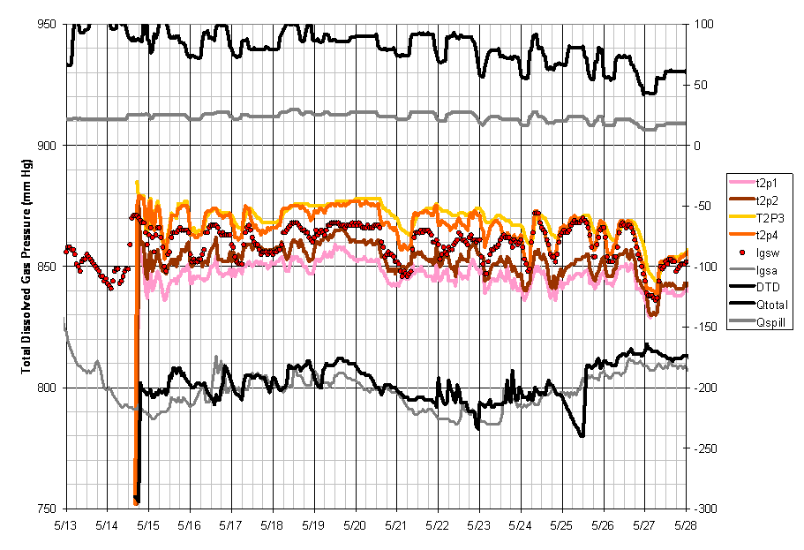
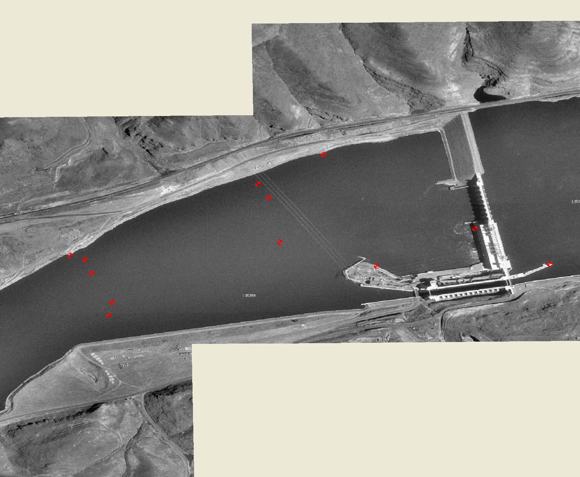
Bonus slide – only if interest or time
2007 Little Goose TDG study
  North bank or fixed TW station near average of T2 transect with south bank lowest during early season with significant PH flow
T1P4
T1P5
T1P3
LGSW
T1P2
DTD
T2P4
T1P1
LGSA
T2P3
T2P1
T2P1

Slide 21
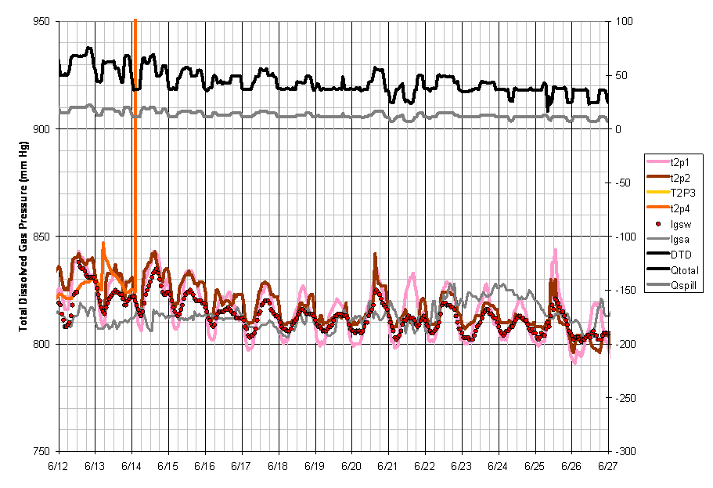
Bonus slide – only if interest or time
2007 Little Goose TDG study
  Late in season with low PH flow south bank of T2 transect both higher and lower than north bank or fixed TW station
  May be indication of higher recirculation even with 30% spill
T1P4
T1P5
T1P3
LGSW
T1P2
DTD
T2P4
T1P1
LGSA
T2P3
T2P1
T2P1

